Slide 1
World Happiness Report
Capstone in Data Analytics and Visualization
Project by : Adva Asraf, Dean Pianica, Maayan Raviv, Olga Kriyokov

Slide 2
1.
Introduction

Slide 3
Happiness is a state of well- being that encompasses living a life one would want, with a sense of meaning and deep contentment.

Slide 4
Intro
Attaining happiness is a global pursuit in which we all take part in. People from every corner of the world tend to rate happiness more as more important than other desirable personal outcomes.
There are many factors that go into what makes people happy, it is not a target that once achieved will last for eternity. Money has been linked to happiness but only to a certain point along with genetic makeup, life circumstances, achievements, social relationships, career paths sense of freedom, one’s surrounding and place of living.But remember not to overload your slides with content

Slide 5
Description of the problem
Our main goal in this project is to study what are the main variable that have the most influence on the life evaluation ladder, the correlation between those variables and how they affect one another.

Slide 6
Data Sets
The Main dataset that we used for this project is the world happiness report which is a well-known source of cross-country data and research on self-reported life satisfaction that ranks 156 countries all over the world.
The additional data set were chosen after we decided that we want to review additional correlation that were not mentioned in the report as Alcohol consumption and weather.
For that we were using:
Happiness Alcohol Consumption Dataset
Countries of The World Datasets

Slide 7
Approach
Reviewing and analyze each dataset separately using Tableau.
Combining all data sets using Python to receive insights and correlation between all variables.
Creating an interactive application using K nearest mean to determine which country suit the most to the user including Mockup.
Cloud computing using Google’s platform and Amazon Web Services.

Slide 8
2.
Tableau

Slide 9
Tableau Initial Review
We reviewed each dataset separately to better understand each the distribution of each variable in each country including Min and Max value.
We created a total of 3 dashboards that help us understand which variables we want to be focus at and we decided to review each continent separately.

Slide 10
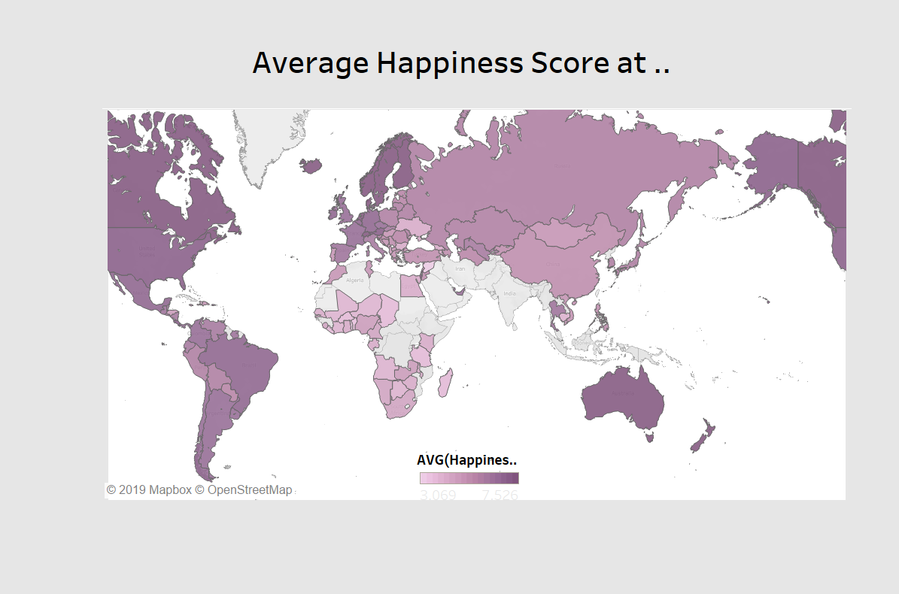
Average Happiness Score
This dashboard helped us to receive initial understanding of the distribution of happiness level.

Slide 11
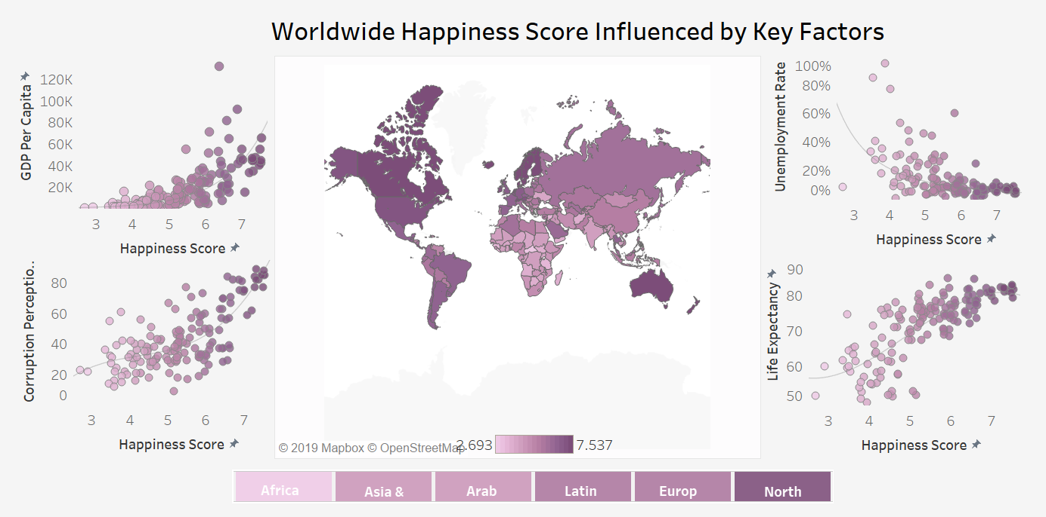
World Happiness Score Influenced by Key Factors
The following dashboard was created after we decided that we want to focus in each continent separately and it enable the user to review each.
This one review correlation between chosen variables from the countries of the world dataset.

Slide 12
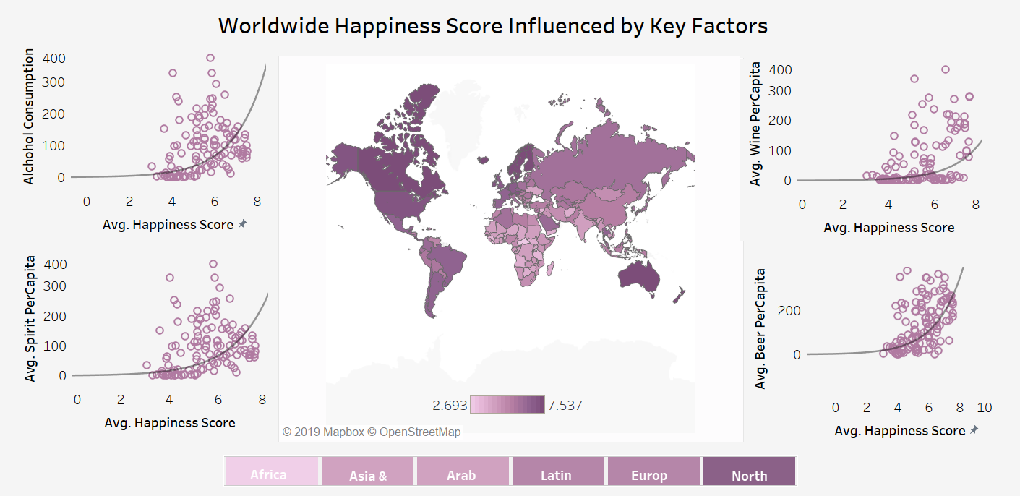
World Happiness Score Influenced by Key Factors
The following dashboard review correlation between chosen variables from the Happiness Alcohol Consumption dataset.

Slide 13
3.
Visualization using Python

Slide 14
Overview
After receiving initial insights using Tableau we used python to combine all data sets to further investigate the following research questions:
What is the overall life satisfaction around the globe?
What is the overall happiness perception around the world broken down to continents?
What are the factors that are most correlated and influential in each continent?
What is the rank of happiness around the world broken down to countries?
What kind of affect does alcohol consumption have on happiness rank and how is it correlated?
What kind of alcoholic beverage consumption is most correlated with happiness rank?
What kind of affect does climate have on happiness rank and how is it correlated?
What kind of affect does birth-rate have on happiness rank and how is it correlated?
What kind of affect does death-rate have on happiness rank and how is it correlated?

Slide 15
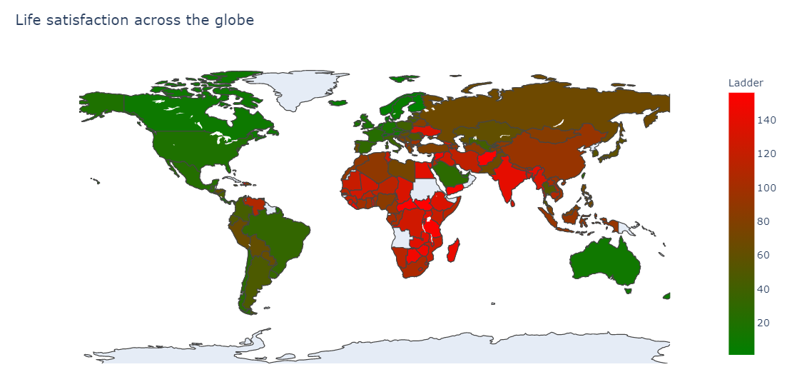
Life satisfaction across the Globe
From the map above, it is clearly to see that North America is the only continent where all states are green. This represent high satisfaction around all countries in United States. Additionally, Africa is the continent that has the lowest life satisfaction and with highest ladder values that are marked in red.

Slide 16
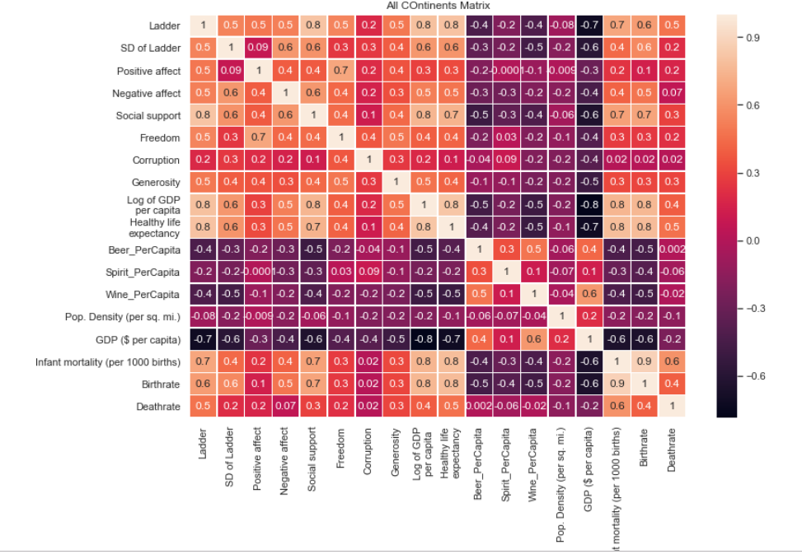
Correlation coefficient analysis
We conducted general correlation matrix for all variables for all countries.
The next step was creating correlation matrix for each continent separate.
According to the result we decided which variable we want to further explore.

Slide 17
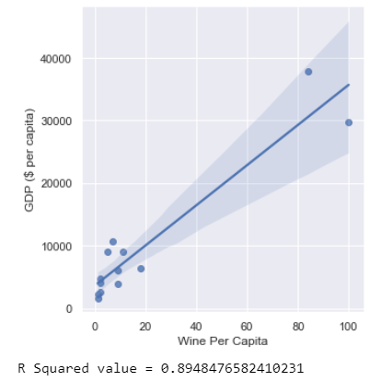
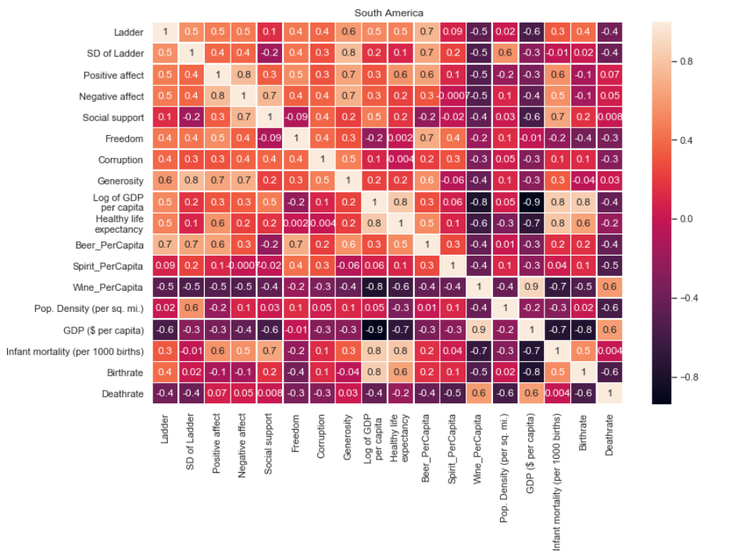
Correlation in South America
For Example in South America, The major difference in correlation was inspected in the correlation between wine per capita to the GDP which suggest that the level alcohol consuming is dependent on the GDP level in the state, so we decided to review those variables separately.
Above is the scatter plot shows in details the correlation between wine per capita consumption to the GDP which appears to be comparative higher in South America, it clearly shows the positive correlation the emphasize that GDP is higher the wine consumption per capita increase as well

Slide 18
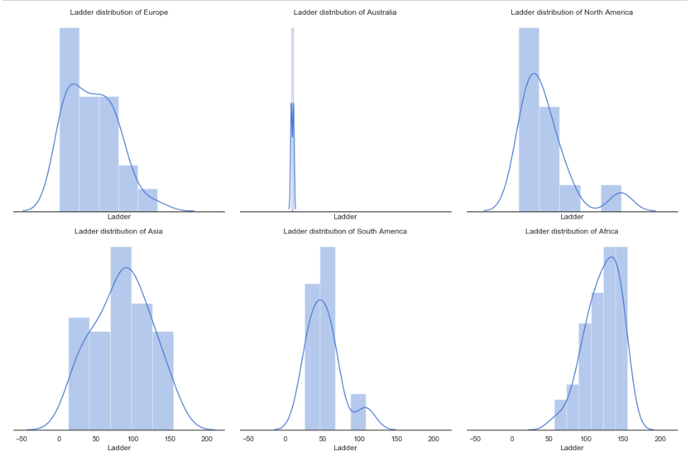
Histogram for each continent per ladder
The histograms above present the distribution of the ladder by continent. In Africa the histogram is left-skewed which means that for most countries the mean is typically less than the median. In North and South America there is an outlier that can be described as extremely high values that do not fall near any other data points or represent unusual cases. In Asia the distribution is almost uniform. In Australia's visualization, New Zealand is also included which leads to unrepresentative sample size The bin size is the same for all graphs since there aren’t any identical values in the ladder's variable.

Slide 19
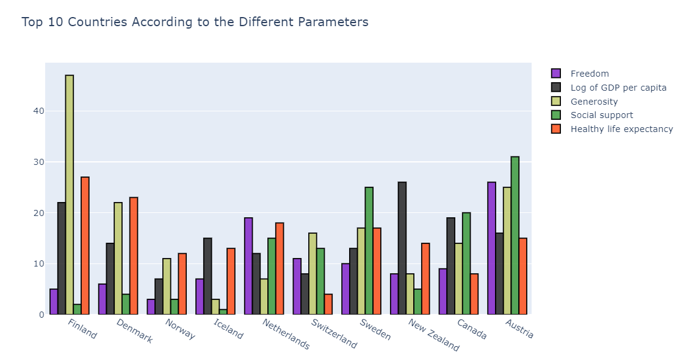
Top 10 countries According By Different Parameters
Top 10 countries that has the highest total happiness score with different key factors variables: freedom, GDP, generosity, social support and healthy life expectancy.
1. Finland has the highest rank in generosity among all other countries.
2. Austria has the highest rank in social support among all other countries.
3. Iceland has the lowest rank in social support.

Slide 20
4.
Application

Slide 21
Creating WHR Application
We wanted to provide people with the chance to explore the data, but in a fun and interactive way. Therefore, we created a simple, six question survey, that aims to predict which countries the surveyor will be happiest living in according to his values and opinions. The results are based upon previous happiness scores from the past 5 years.

Slide 22
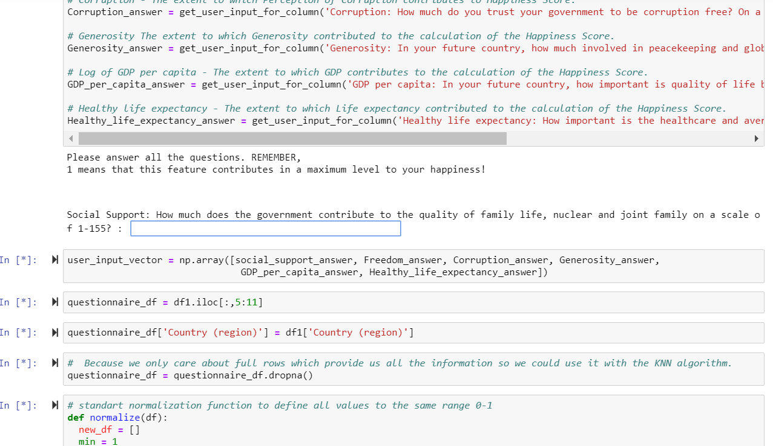
Answer our survey questions

Slide 23
Let’s take a closer look to our App
https://projects.invisionapp.com/d/main#/console/18229311/378464729/preview

Slide 24
5.
Cloud

Slide 25
Cloud Computing
We used Amazon Web Services and Google Compute Platform in order to use on-demand availability of our code and analysis.
Our activation instances commands are:
Google Cloud Instance Access
ssh -i gcloud_instance_key yucapstone@104.197.234.160
AWS Instance Access
ssh -i "ec2Instance.pem" ubuntu@ec2-35-177-2-216.eu-west-2.compute.amazonaws.com
Run On Cloud Instances
jupyter notebook --no-browser --port=8888
Access EC2 Instance Notebook
ssh -i ec2Instance.pem -L 8000:localhost:8888 ubuntu@ec2-35-177-2-216.eu-west-2.compute.amazonaws.com
Access GCloud Instance Notebook
ssh -i gcloud_instance_key -L 8000:localhost:8888 yucapstone@104.197.234.160

Slide 26
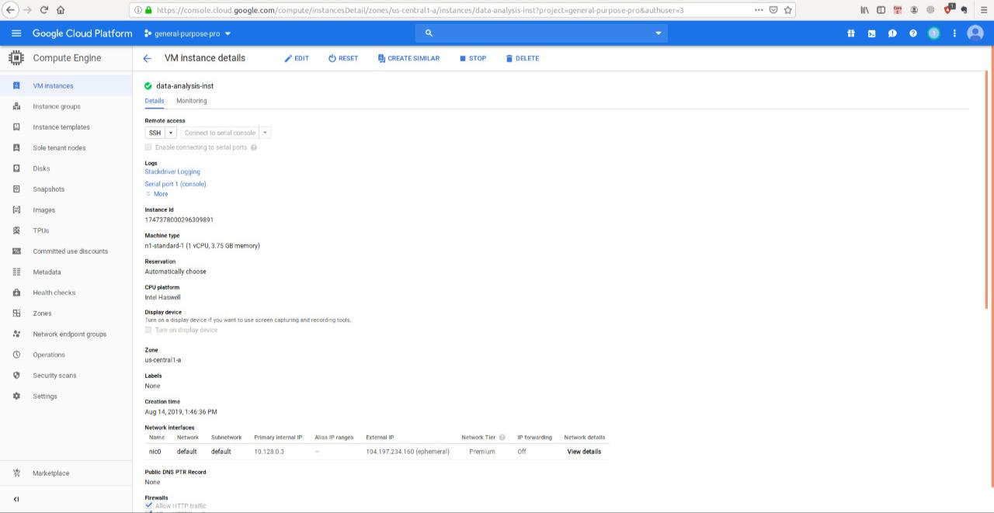
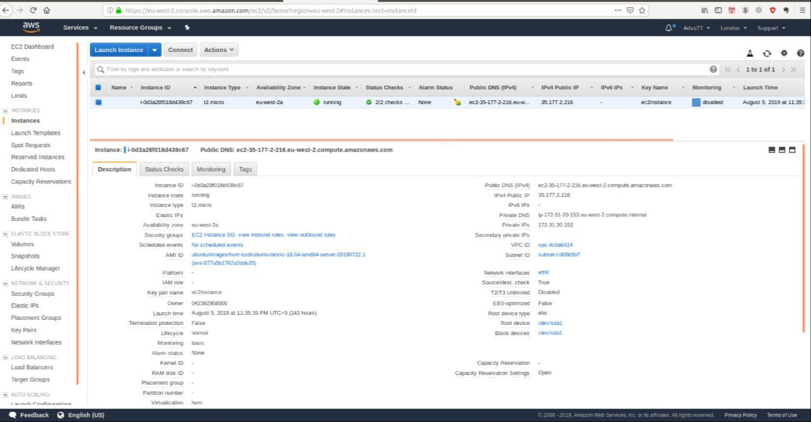
Cloud Computing
Amazon Web Services
Google Compute Platform

Slide 27
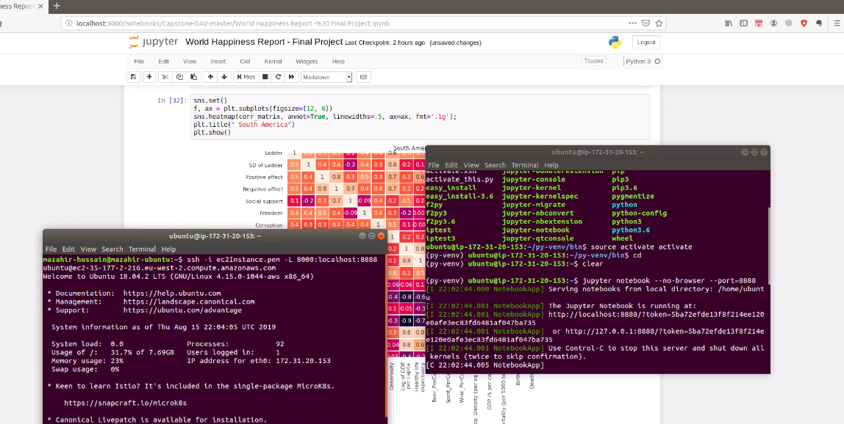
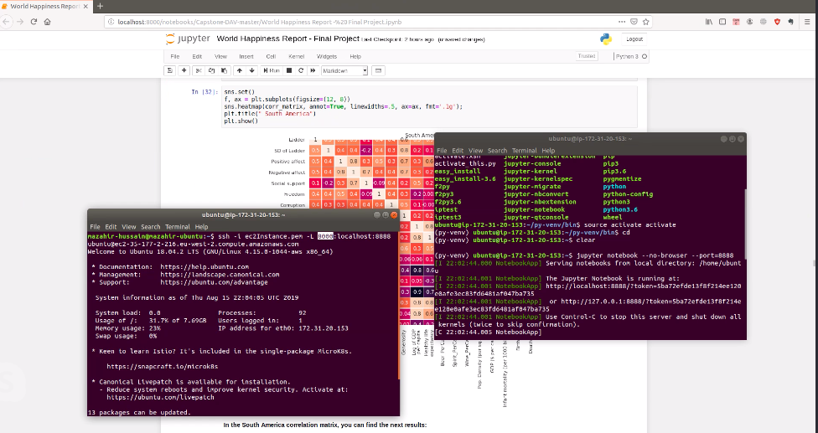
Cloud Computing

Slide 28
6.
Insights

Slide 29
Insights
Created a map presenting the happiness rank in different countries, drilled down to a micro view that will provide us with a bigger picture that includes states.
9 of the happiest countries are located in Europe, with different levels of key factors that influence the ladder rank.
There are some critical variables like: GDP, freedom, corruption, infant mortality and healthy life expectancy that effect directly the ladder rank.
Regards to Europe's alcohol consumption: the most significant correlation that we have is to different spirits. While wine and beers have low and moderate negative correlation.
Correlation between alcohol consumption (beer, wine and spirits) has almost no influence on parameters like ladder rank, positive affect and negative affect.
Exploring factors that relate to the population, birth rate, death rate and infant mortality rate in each continent : Africa is the continent that has the highest birth rate and infant mortality rate.
The top 3 countries that have the highest happiness score: North America, United States received the highest score among the other countries. In Asia, Israel was in the top 3 among with Taiwan and the Arab Emirates. This analysis gave us a perspective on the countries and their total score.

Slide 30
Thanks!

